Slide 1
ALARM

Slide 2
What is ALARM?
A
Learning
And
Responding
Matrix

Slide 3
So what is a matrix?
It is simply an organisational structure system.

Slide 4
What is ALARM?
Alarm is an approach that teaches students to learn the content of their courses at the levels required by the HSC question verbs; describe, explain, as they measure learning in very specific ways.
Learning and Responding are two of the most important skills you will gain while you are at Wyndham. You do it in EVERY subject and EVERY task.

Slide 5
What can I gain from ALARM?
An understanding of the hierarchy of learning and responding skills.
From
Identifying and describing
through
To
The evaluation and appreciation of that understanding.

Slide 6
How effective is it?
Almost every subject in the HSC contains a written exam.
These exams ask different types of questions which require students to demonstrate not only what they know, but to apply that knowledge in a number of different ways.

Slide 7
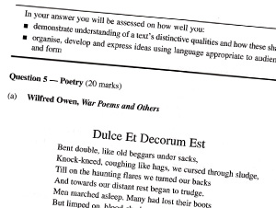
How does this apply to questions?
ALARM teaches students how questions work.
This is important because not all questions require the same level of understanding or the same level of response.
To be effective in an exam, students need to know what level and type of response is required as well as the content.

Slide 8
Types of questions
Name and define
Describe
Explain
Analyse
Critically analyse
Evaluate
Level 1 (Name & Define) is the simplest and level 6 (evaluate) is the most demanding.

Slide 9
ALARM in ENGLISH ADVANCED & STANDARD
A.L.A.R.M. | Words that direct you | Words/terms to use when responding
Name and define | Identify What Select Outline | Techniques eg: Simile Personification Repetition Dialogue Camera angle

Slide 10
Describe
Describe
Describe | Demonstrate understanding of List features or attributes Give Present | Details Outline/paraphrase scene Quote example “…opening scene focuses On..”

Slide 11
Explain
Explain
Explain | Why Provide a reason Investigate Cause and effect Explain Script | This links to the Concept/question Shows the relevance of quote. Demonstrates significant/important Shows function of

Slide 12
Analyse
Analyse
Analyse | How - Create What impact Compare / Contrast Develop Explore Analyse | Technique…. Emphasises how… Explores how…. Conveys how… Reinforces/supports how….

Slide 13
Critically Analyse
Critically Analyse
Critically analyse | Discuss - Represent Comment on the significance Explore the impact Examine Critique Compare Appreciate | Convincingly Powerfully Skilfully Cleverly Poorly Positive or negative Beneficial or not Contrast and comparison

Slide 14
Evaluate
Evaluate
Evaluate | To what extent Express your ideas How has your learning developed Judgement Justify Comment | CONCLUSION: Therefore X is more effective than Y X is a more successful text in achieving purpose X is a more beneficial text in relation to concept The responder feels/understands or reacts etc Reaffirms understanding Appreciation of text

Slide 15
Exercise
A mobile phone.
Working in pairs, you have five minutes to complete the ALARM exercise of the mobile phone.

Slide 16
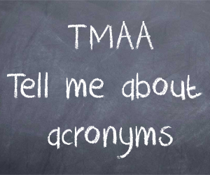
Where does STEAL/STEEL and other acronyms used in different subjects fit in?
Example used in English:
Statement; Critically analyse – Evaluate
Technique; Name and Define
Example; Describe
Explain; Analyse – Evaluate
or
Analyse; Analyse – Evaluate
Link; Analyse

