Slide 1
ALARM
Presentation for staff
Industrial Technology, CAFS, Construction, Design & Technology, Food Technology

Slide 2
What is ALARM?
A
Learning
And
Responding
Matrix

Slide 3
How does that work?
Alarm is an approach that teaches students to learn the content of their courses at the levels required by the HSC question verbs; (eg:describe, explain) as they measure learning in very specific ways.
Learning and Responding are two of the most important skills learnt while at Wyndham. It is done in EVERY subject and EVERY task.

Slide 4
What can I gain from ALARM?
An understanding of the hierarchy of learning and responding skills.
From
Identifying and describing
through
To
The evaluation and appreciation of that understanding.

Slide 5
How effective is it?
Almost every subject in the HSC contains a written exam.
These exams ask different types of questions which require students to demonstrate not only what they know, but to apply that knowledge in a number of different ways.

Slide 6
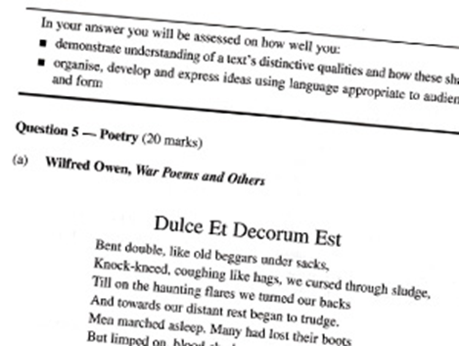
How does this apply to questions?
ALARM teaches students how questions work.
This is important because not all questions require the same level of understanding or the same level of response.
To be effective in an exam, students need to know what level and type of response is required as well as the content.

Slide 7
Types of questions
Name and define
Describe
Explain
Analyse
Critically analyse
Evaluate
Level 1 (Name & Define) is the simplest and level 6 (evaluate) is the most demanding.

Slide 8
Industrial Technology
Taken from 2013 HSC Examination paper Section III
Question 16 (15 marks)
(a) Explain why a company should comply with safety standards. (6)
(b) Assess strategies that a company could implement to establish and maintain a safe work culture (9)

Slide 9
Explain
BOS Definition: Relate cause and effect; make the relationships between things evident; provide why and/or how.
To make known in detail: to explain how to do something. Dictionary.com
‘Explain’ in the paper is positioned as a statement rather than a question to promote an authoritative response.

Slide 10
Words/phrases to use when responding
This links to the concept/question…
Shows the relevance of quote….
Demonstrates….
significant/important….
Shows function of……

Slide 11
Assess
BOS definition: Make a judgement of value, quality, outcomes, results or size.
To estimate or judge the value, character of; evaluate. Dictionary.com
In this case for this part of the response, the verb is essentially drawing the student to respond at a high level of interpretation of the papers required understanding – ‘Evaluate’ represents the highest order which is reflected also in the mark value.

Slide 12
Decoding is the key
A correct analysis of how the verb (along with the syllabus metalanguage) is directing the student to respond is essential to completing their answer completely and thoroughly.

Slide 13
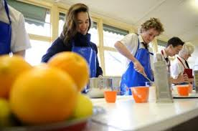
Food Technology
Taken from 2013 HSC Examination paper Section III
Question 28 (2 marks)
(a) Outline an emerging technology that you have investigated in ONE sector of the Australian food industry (2)

Slide 14
Outline
This is a verb that simply requires the student to ‘Name and Define’ in their response and is reflected in the mark value.
BOS definition: Sketch in general terms; indicate the main features of.
A general sketch, account or report, indicating only the main features, as of a book, subject or project. Dictionary.com
One of the prime concerns in the examination situation is for students to recognise that simpler verbs with less higher order requirements require less time to complete and should form part of their understanding of time management.

Slide 15
CAFS
Question: Discuss the issues of concern between ONE group you have studied and the wider community.
‘Discuss’
BOS definition: Identify issues and provide points for and/or against
To consider or examine by argument, comment; write about or talk over, especially to explore solutions; debate.
Dictionary.com
This question draws the student into a situation where they are effectively required to compare and contrast which falls between analyse and critically analyse in the ALARM scale.

Slide 16
Synonyms and responses
Discuss - Represent
Comment on the significance
Explore the impact
Examine
Critique
Compare
Appreciate
Convincingly
Powerfully
Skilfully
Cleverly
Poorly
Positive or negative
Beneficial or not
Contrast and comparison

Slide 17
Construction
Taken from 2013 HSC Examination paper Section IV
Question 23 (15 marks)
During an excavation on a construction site, a gas line explodes resulting in a number of workers being injured.
Describe the emergency procedures to be followed in response to this critical incident. (3)
What documentation and communication will be required by management after the immediate response to this critical incident? (4)
Explain the risk management assessment process that should have been implemented to prevent the accident. (8)

Slide 18
Describe
Describe – Provide characteristics and features. (within this explanation lies a point that ALARM also tries to address with reference to vocabulary).
Demonstrate understanding of
List features or attributes
Give
Present
‘What’ is classified as ‘Name & Define’ (level 1) and ‘Explain’ has been covered earlier.

Slide 19
Design & Technology
Taken from 2013 HSC Examination paper Section III
Question 15 (15 marks)
Explain how new technologies are affecting Australian lifestyles (6)
Analyse the relationship between emerging technologies, society and a designer’s vision in regard to the development of a new product, system or environment. (9)
The structure of these responses does not allow for the student to simply, name or describe. It requires them to carefully structure and plan their responses and utilise the base acronyms employed within different subject areas (STEAL, PEAL etc.)

Slide 20
Tips for success
Student must familiarise themselves with the meanings of verbs in order to successfully respond to the question.
Vocabulary is key in assessing the meaning of the verb while also allowing them to recognise other directives within the question/statement.
Plan for their answers. Drafting is key in the preparation for the exams, however carefully planning a response in the exam can be assisted by not simply rushing into their responses once reading time is completed, but taking a further few minutes to annotate the question and highlighting the key areas.
Allow for how the interpretation of the question will affect time management and length of response.

